Slide 1


Audio/Video System
Quick Reference Guide
Pacific Conference Room

Slide 2


Welcome Page
When approaching the control panel it may be blank. Touch anywhere on the display section to bring up the start page.
To use the Display System press the Start System Button.

Slide 3
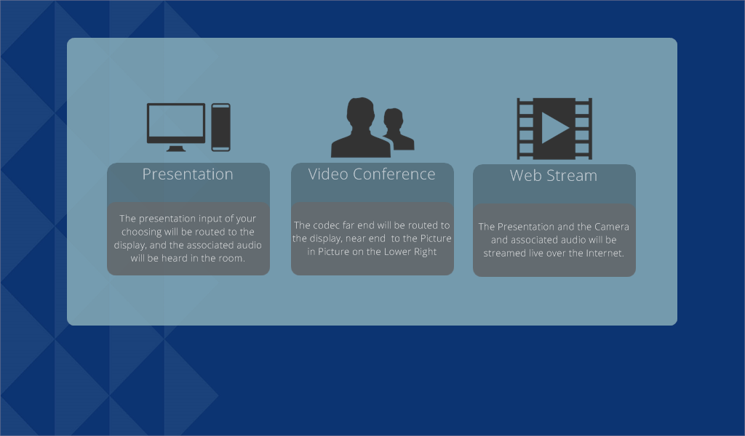
Home Page
Press this button to do a Video Conference Call
Press this button to do a Normal Presentation
Press this button to do a Web Stream
After Starting the System, The Home Page will appear. Selecting one of the Buttons will allow you to choose what you want to do with the System. It provides presets to assist the user in doing their chosen Task (Presentation, VTC, or Web stream).

Slide 4
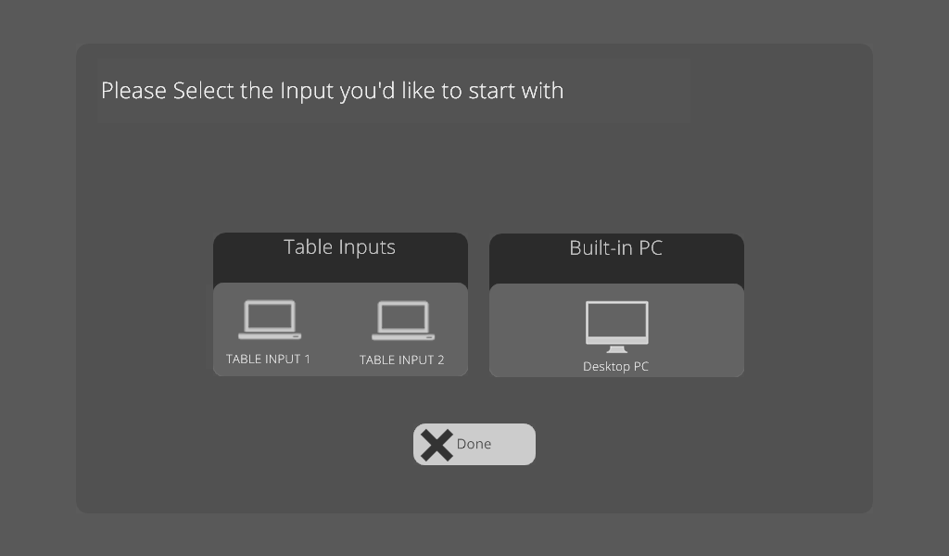
Presentation Preset
Press this button to do a see the Front Table Input
Press this button to see the PC in the Rack
Press this button to do a see the Rear Table Input
Press this button to go back to the Home Page
After Pressing the Presentation Button, the Presentation Preset Page will appear. Pressing one of the three buttons on this Page will turn the system on with the selected Source showing on the display.

Slide 5
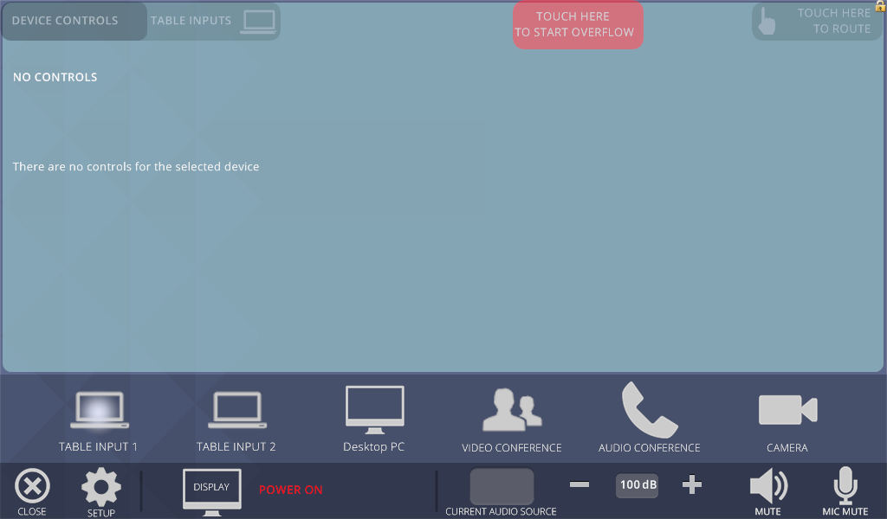
Main Page
Starts and Stops the Overflow Functions
Brings up the Routing Page
Sources
Mutes Microphone Audio
Brings up the Confirmation Page
Shows the Current Audio coming over the Speakers
Mutes Program Audio
Brings up the Setup Page
Raises the Program Audio
Shows the Display Power status and the Phone Call Status
Lowers the Program Volume
Shows the Program Volume Level
After Selecting a Source on the Presentation Preset Page, The Main Page will appear. Selecting a Button on the Bottom will allow you to choose what Video Source you want to see. Selecting the “Touch Here to Start Overflow” button will start (Red) and stop (Green) the Overflow to the ES and Large Conference Rooms. This will allow those rooms to see your presentation and hear your audio

Slide 6
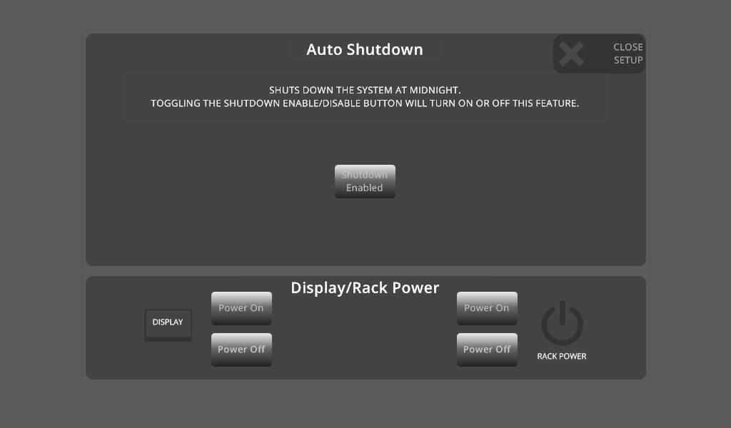
Setup Page
Press this to close the Setup Page
Auto Shutdown Control Button
Controls the Power to the Sharp Display in the Room
Controls the Power to the Sharp Display in the Room
After Pressing the Setup Button, the Setup Page will appear. Here you can control the Display Power, Rack Power, and the Auto Shutdown Routine. Here you can enable/disable the Auto Shutdown, Turn on and off the Display, and Turn Power On and Off to the Rack.

Slide 7
Table Input 1 Page
Table 1 Input Source Button
After Pressing the Table 1 Button, the Table Input 1 Page will appear. This will cause the Front Table input to appear on the Main Screen. It will also send it to the Video Conference System and to the Overflow (If enabled).

Slide 8
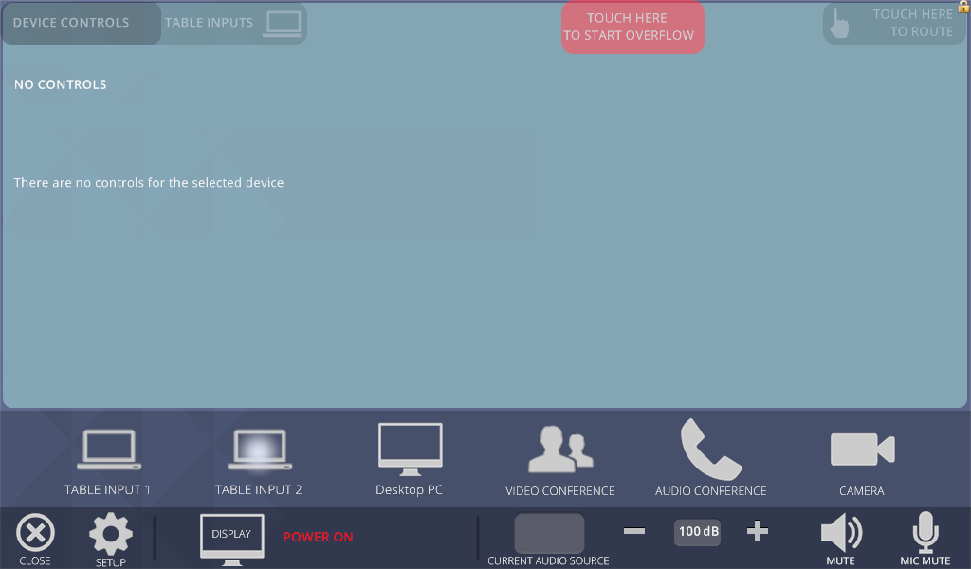
Table Input 2 Page
Table 2 Input Source Button
After Pressing the Table 2 Button, the Table Input 2 Page will appear. This will cause the Rear Table input to appear on the Main Screen. It will also send it to the Video Conference System and to the Overflow (If enabled).

Slide 9
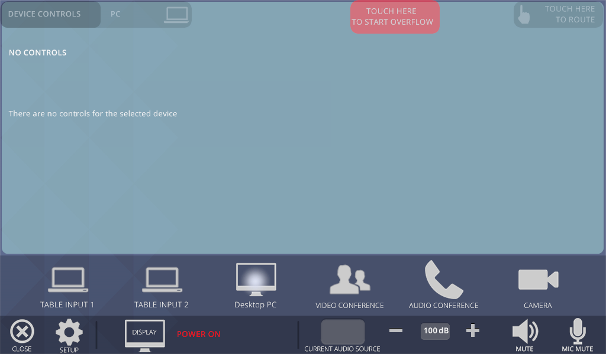
Desktop PC Input Page
Desktop PC Input Source Button
After Pressing the Desktop PC Button, the Desktop PC Page will appear. This will cause the Desktop PC input to appear on the Main Screen. It will also send it to the Video Conference System and to the Overflow (If enabled).

Slide 10
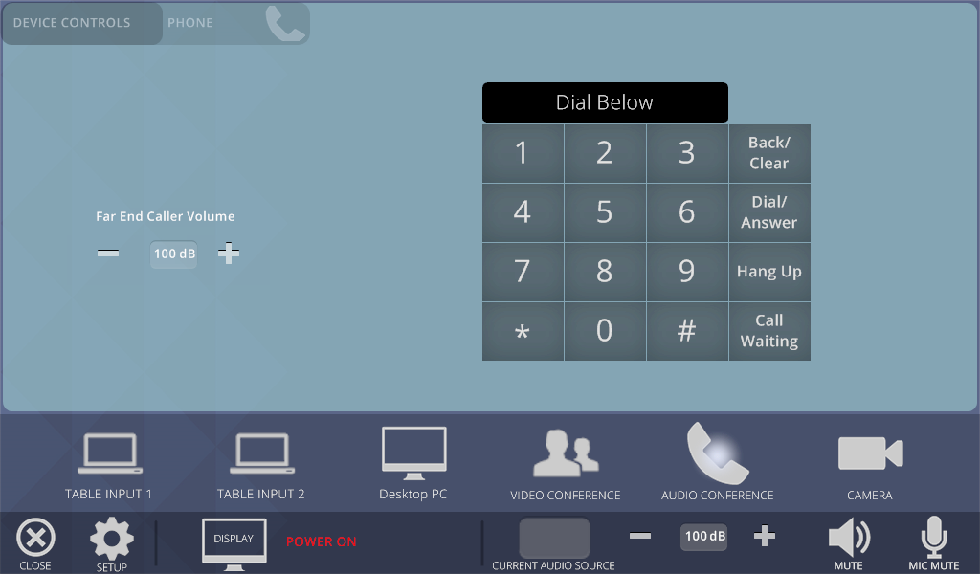
Phone Page
The Current Dialed Number is Shown here.
Dialing Buttons
Raises the Caller’s Audio
Lowers the Caller’s Audio
Caller’s Audio Level
Phone Source Button
After Pressing the Phone Button, the Phone Page will appear. Use the Dialing Buttons to dial Traditionally.

Slide 11
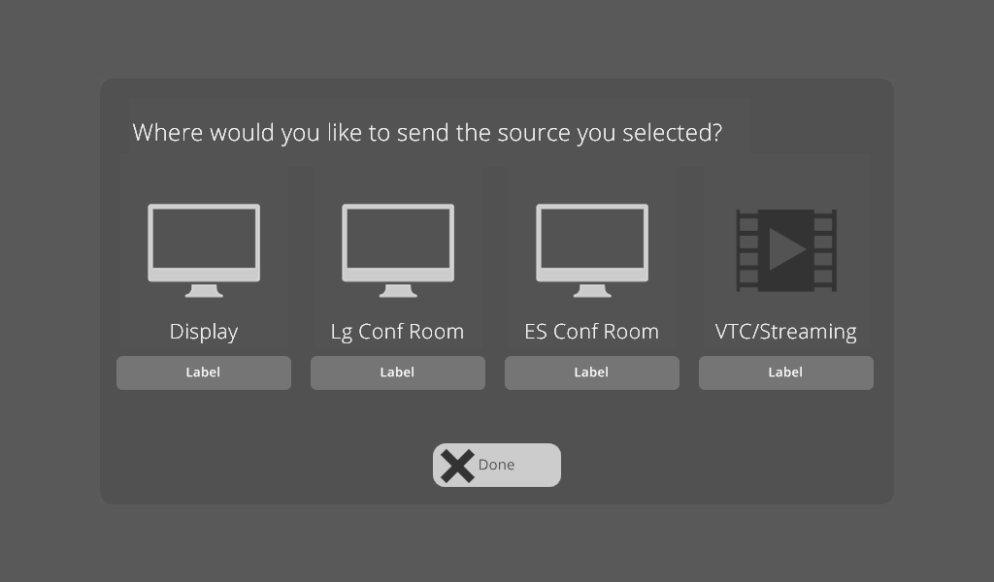
Routing Page
Destinations
Shows the Source showing on the Screen
This closes the Routing Page
After Pressing the “Touch Here to Route” Button, the Routing Page will appear. Pressing one of the Destination Buttons will allow the source to be seen on that Screen. Pressing and holding a Destination Button will remove it from the Screen.

Slide 12
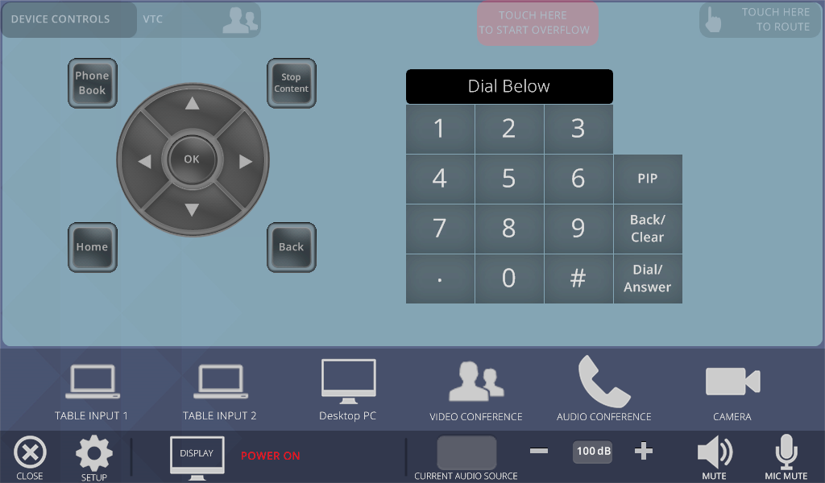
VTC Page
Stops Sending
Dialing Buttons
VTC Menu Controls
VTC Source Button
After Selecting the Video Conference Button, The Main VTC Page will appear. This will allow you to make a VTC Call, and control the Menus on the VTC System.

Slide 13
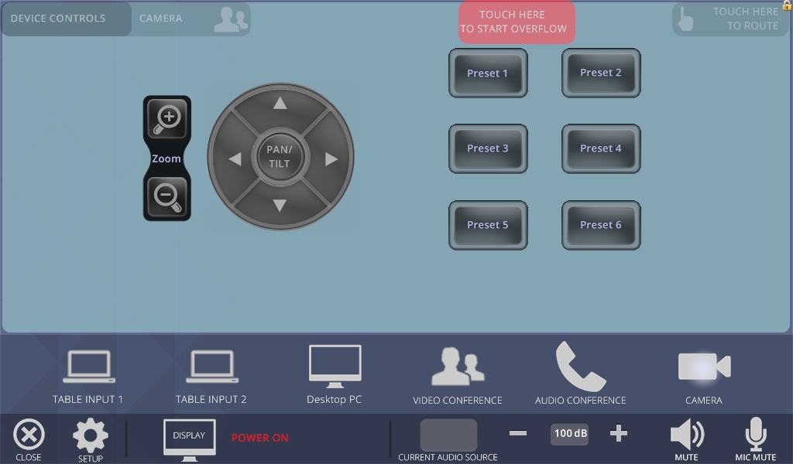
Camera Page
Camera Preset Controls
Camera Pan/Tilt/Zoom Controls
Camera Source Button
After Pressing the Camera Button, the Camera Page will appear. Pressing on one of the Preset buttons will recall a Preset. Pressing and Holding a Preset button will save it for later Recall.

Slide 14

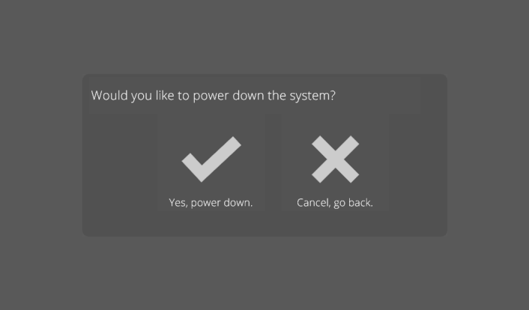
Power Down Page
From the Main Page press the Close button.
Then press the “Yes, Power Down” button to turn the system off.

Slide 15
Service Resource Guide
Monitor is on but no image
Are all cables properly connected
Is laptop output toggled on?
Is the device turned on?
Call our office for service (336) 714-0564
I see the image but hear no sound
Check the “mute” button
Select and press volume up then volume down
Has someone turned the amplifier off at the rack
Call our office for service (336) 714-0564

Slide 16
Service Resource Guide
Nothing works
Was system power turned on from the touch panel power page?
Was there a recent power failure or surge. Check the power at the rack. Insure the power cord is plugged in?
Turn the rack off (Unplug the rack, then re-plug). The system may need to be re-set wait 90 seconds then try the touch panel.
Call our office for service (336) 714-0564

Slide 17
For Service, contact:
Tonya Allen at
(336) 714-0564 tonyaa@strategicmail.net

Slide 18
For Sales Contact:
Dan Williams at (919) 900-4001
DanW@strategicmail.net

